Slide 1
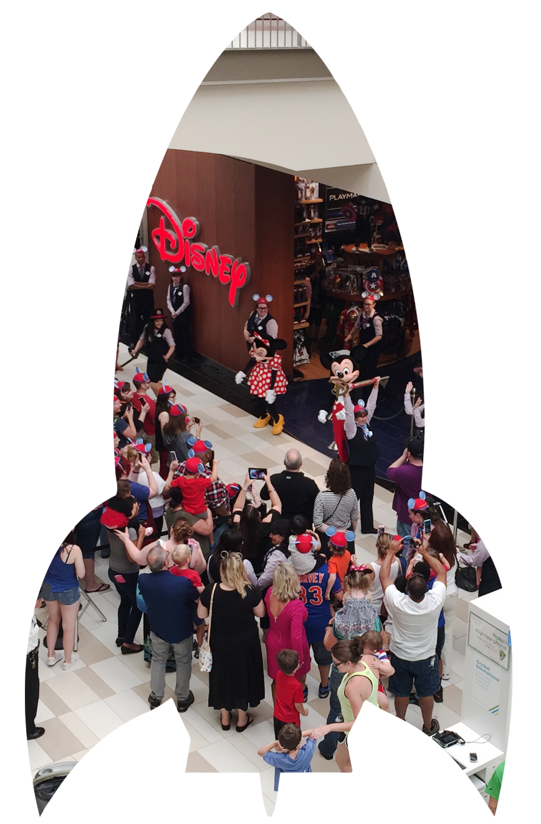

Slide 2
Unparalleled on-site marketing and advertising support over 90 days to help propel your brand to its biggest and best grand opening ever.

Slide 3
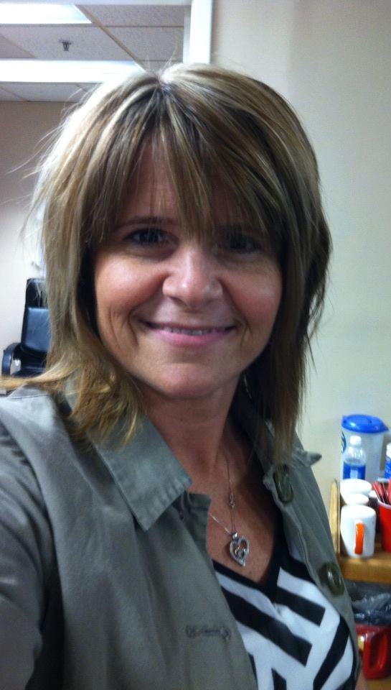
Karla Woods
Marketing Director
315-788-9210, ext. 205

Slide 4
Rocket Booster Phase ($9,800 value)
90-Days FREE On-site Digital Advertising
(30 Days Pre-Open, 30 Days
Now Open, 30 Days Post-Open)
Dynamic Digital Directory Ad
($1,800 Value)
Website Banner Ad
($1,500 Value)
Email Marketing Ads
($1,500 Value)
Social Media Ads
($5,000 Value)
Tenant ads placed on 65” digital “touch” directories (tenant provides creative)
Tenant homepage banner ad posted to mall website
Dedicated e-blast to database; 3 banner ads in weekly emails to customers, 3 in tenant newsletters
2x posts (4/mo.) promoting brand with gift card giveaways (supplied by tenant); 2x Facebook Live video posts

Slide 5

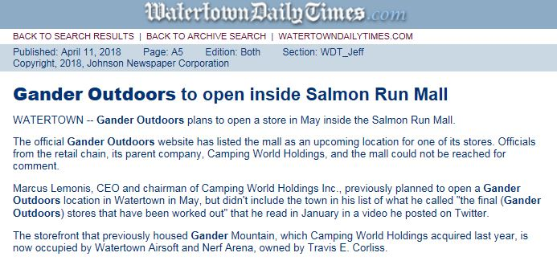
Earned media is incredibly important for a successful opening. Our on-site marketing team maintains relationships with local and regional media outlets to get your store maximum exposure. Prior to opening, you'll work with the on-site team to draft and coordinate the distribution of a press release announcing your brand’s arrival, and it’s big grand opening.
Media Outlets:
• Print
• Broadcast
• Radio
• Bloggers
• Online Influencers

Slide 6
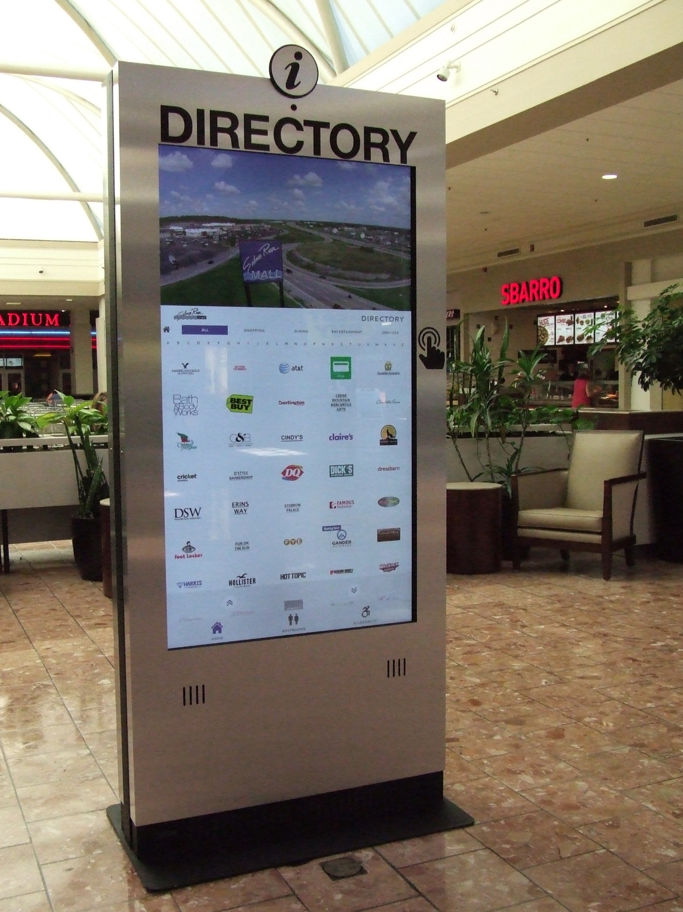
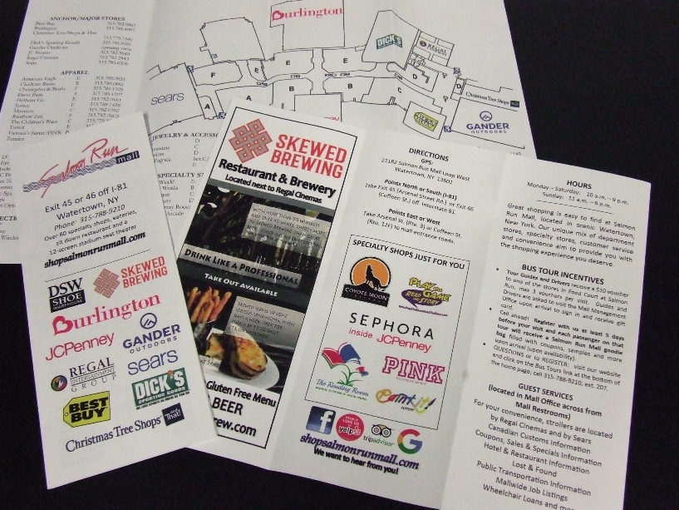
Wayfinding boosts your store’s visibility and helps customers easily find your new location. From freestanding interactive 65” digital touch directories to printed directories complete with center map, there’s no better way to build your brand’s awareness and start driving traffic—and sales.
• Digital Directories: Six locations throughout Salmon Run Mall
• Print Directories: 3,000 printed quarterly

Slide 7
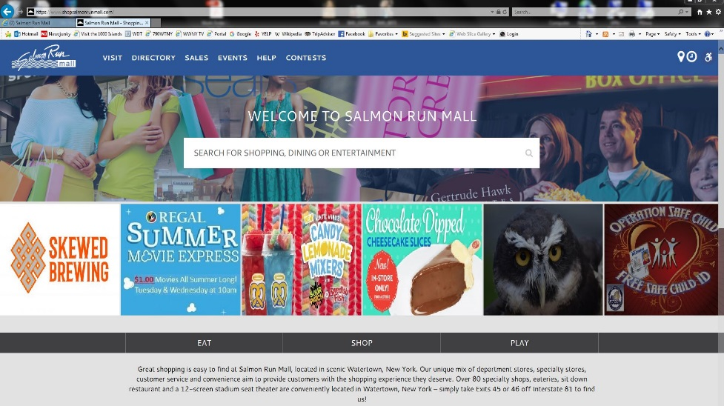
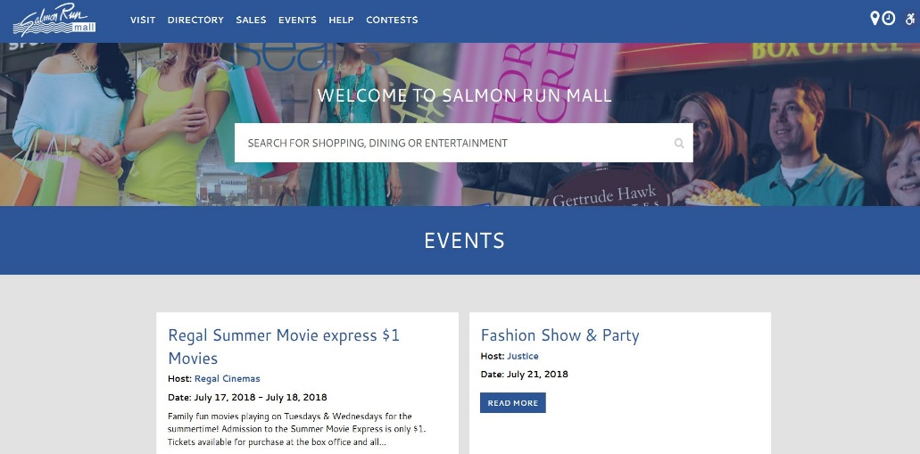
We’ll work with you to place your store's name, logo, map location, contact information and description on www.shopsalmonrunmall.com, making it easier for customers to find you before they visit.
What’s more, gain access to our exclusive free Merchant Portal which allows you to post sales, jobs and events directly from your mobile device to our website.
• Website: receives 114,310 sessions between 86,296 users; averages 2.83 pages per section with an average session duration of 1 minute 43 seconds.
• Merchant Portal: Login credentials available through your on-site marketing team.

Slide 8
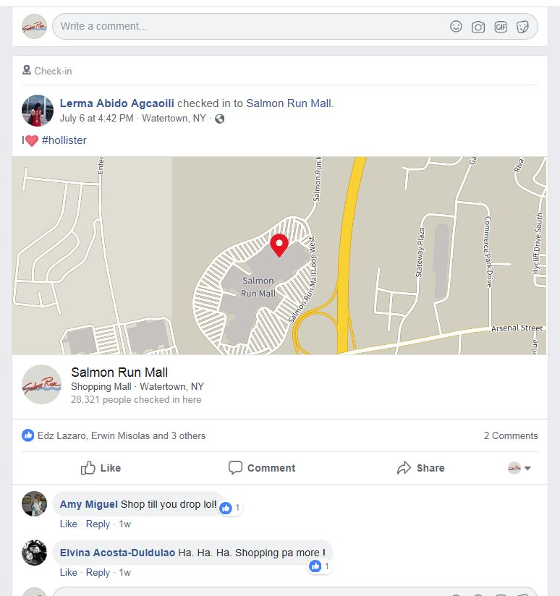
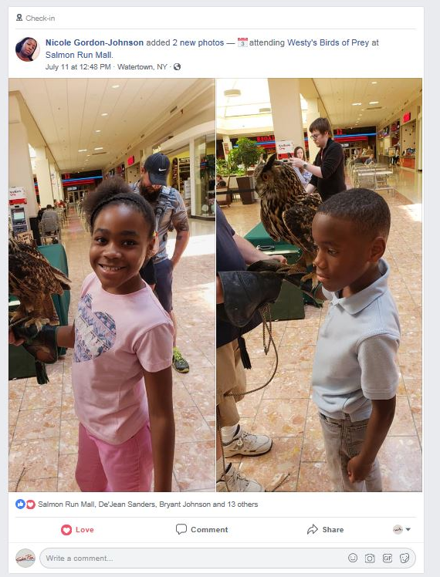
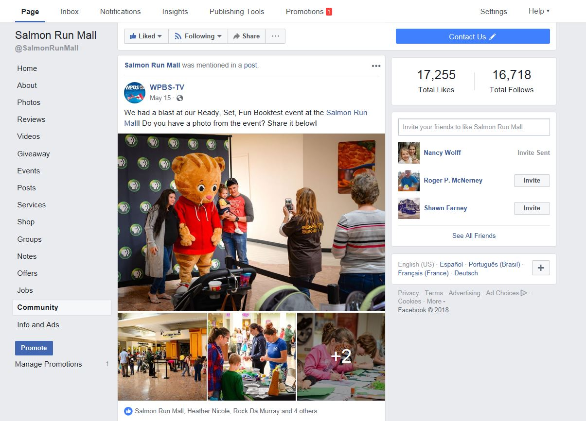
Take advantage of our massive social media following by getting your brand noticed on today’s most popular social media channels. Our on-site team will help you post your original content, driving buzz, excitement and traffic for your opening.
Social Reach:
Facebook: 17,255 likes

Slide 9

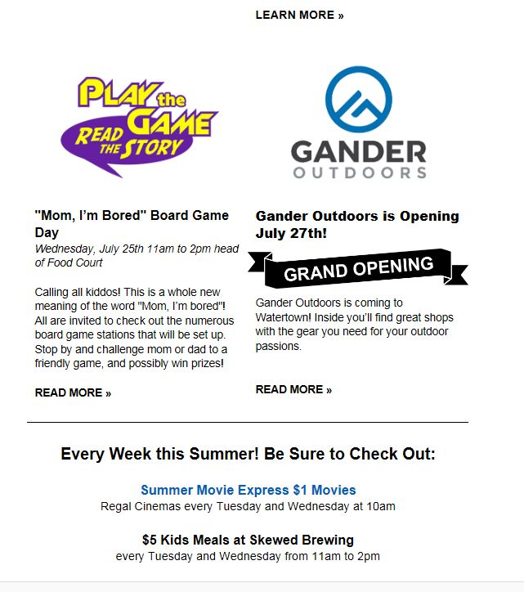
Drive traffic and awareness for your store’s opening with high-impact email marketing. Our onsite team will get your brand plugged into email campaigns to reach a broad audience of potential customers.
Email Database Size:
1,536
Open Rate:
16%
Click-Thru Rate:
2%

Slide 10
$9,800

Slide 11
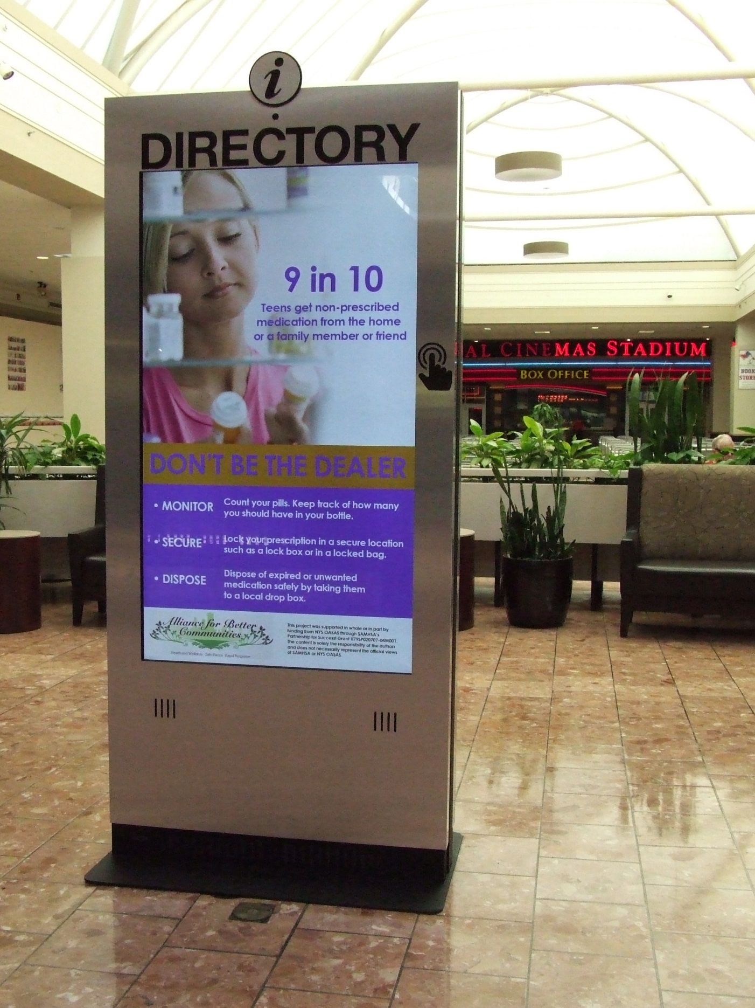
$1,800
Make a splash and get your store noticed with a free ad on our new 65” freestanding digital directory screens, located in highly trafficked areas throughout the center. Directories can play HD video and audio for big impact.
Digital Ad Screen Specs:
• 65” Screens
• :15 ad spots
• 1080px wide 1920px tall
• 72 dpi
• .jpeg, .png, .mp4
Double-Sided Video Specs:
• 8 Ad Rotation
• :15 second videos available
• 4x3 or 16x9 ratio video- .mp4 or .mov horizontal
• Frequency: Each :15 second video runs an estimated 37,180 times per day
NOTE: Tenant responsible for providing copy and ad creative. Ads must adhere to specs and are subject to approval by the on-site team prior to posting.

Slide 12
$1,500
Our on-site team will place your store’s website banner ad directly on the homepage of www.shopsalmonrunmall.com for the biggest impact possible.
Ad Specs:
• 1000px by 500px horizontal
• RGB, 72ppi, .jpg or .png

Slide 13
$1,500
Place an email marketing banner ad in three upcoming email blasts for Salmon Run Mall.
Ad Specs:
• 600px by 110px horizontal
• RGB, 72ppi, .jpg or .png

Slide 14
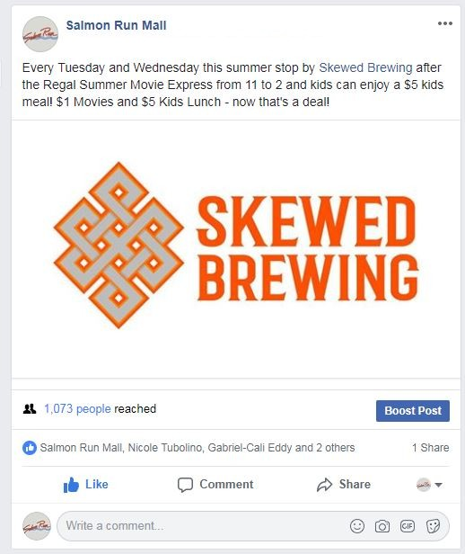
$5,000
As a part of your opening, you’ll receive social media posts promoting your brand with exclusive giveaways such as gift cards supplied by tenant.

Slide 15
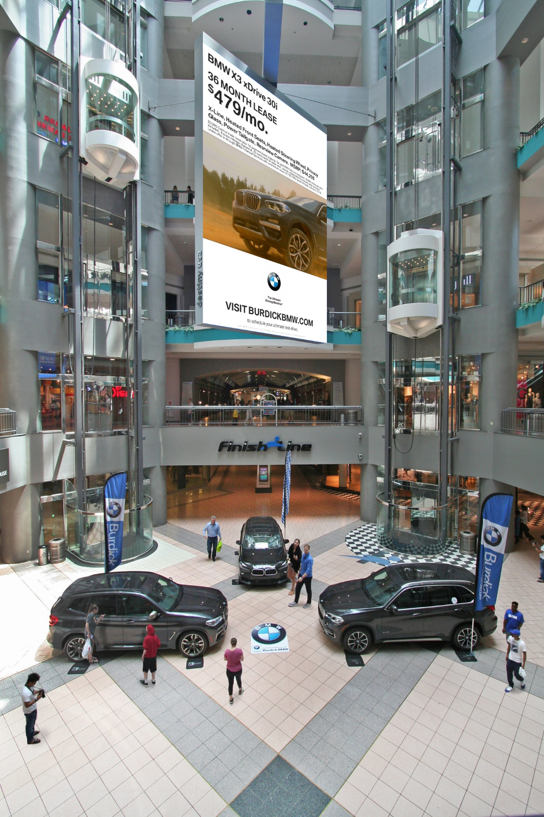
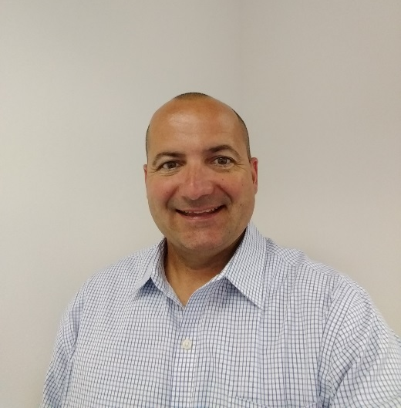
Additional advertising opportunities are available outside of the scope of the Pyramid Launch Pad. If you are interested in reaching even more potential customers in additional ways, please contact your Pyramid Advertising Solutions representative today.
INSERT AD REP PHOTO
Tom Kennedy
tomkennedy@pyramidmg.com
315-410-6643
Additional Opportunities Available:
Event Sponsorships, Recruiting, Center Branding

